Slide 1
Listening and integrated skills A2
Instructor: Nguyen Ha Phuong

Slide 2
Unit 2: Good times, good feelings
Pages 21-40

Slide 3
Lesson objectives
By the end of the lesson, students will be able to:
use abstract nouns.
understand a speaker’s purpose.
use a split page to take notes.
recognize assumptions.

Slide 4
TABLE OF CONTENTS
01
02
03
04
05
VOCABULARY A
LISTENING A
VIDEO WATCHING
VOCABULARY B
LISTENING B

Slide 5
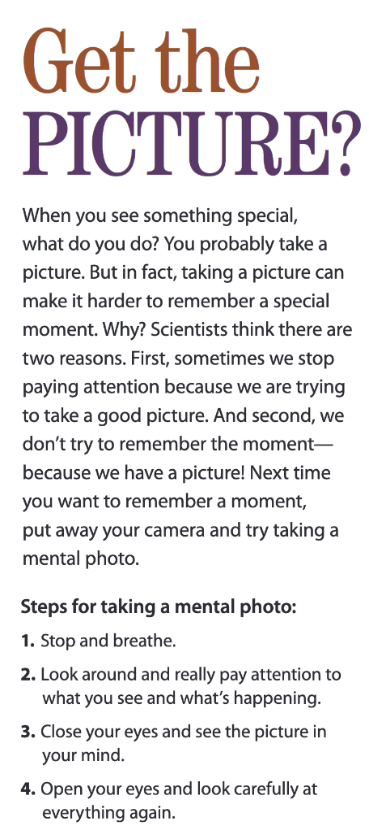
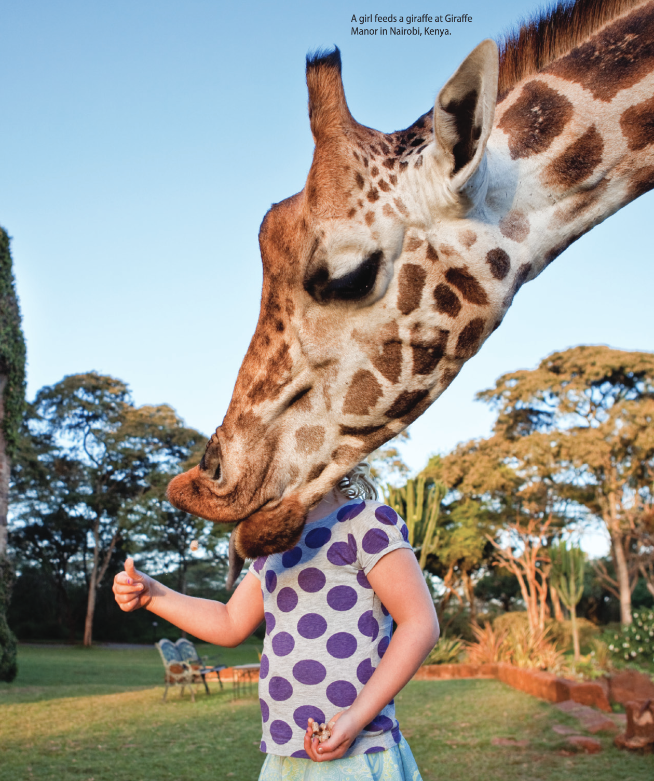
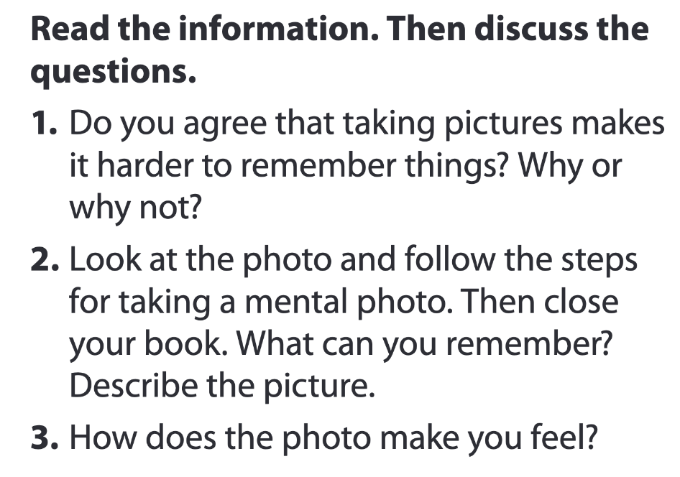
Pages 22-23

Slide 6

01
Vocabulary A

Slide 7

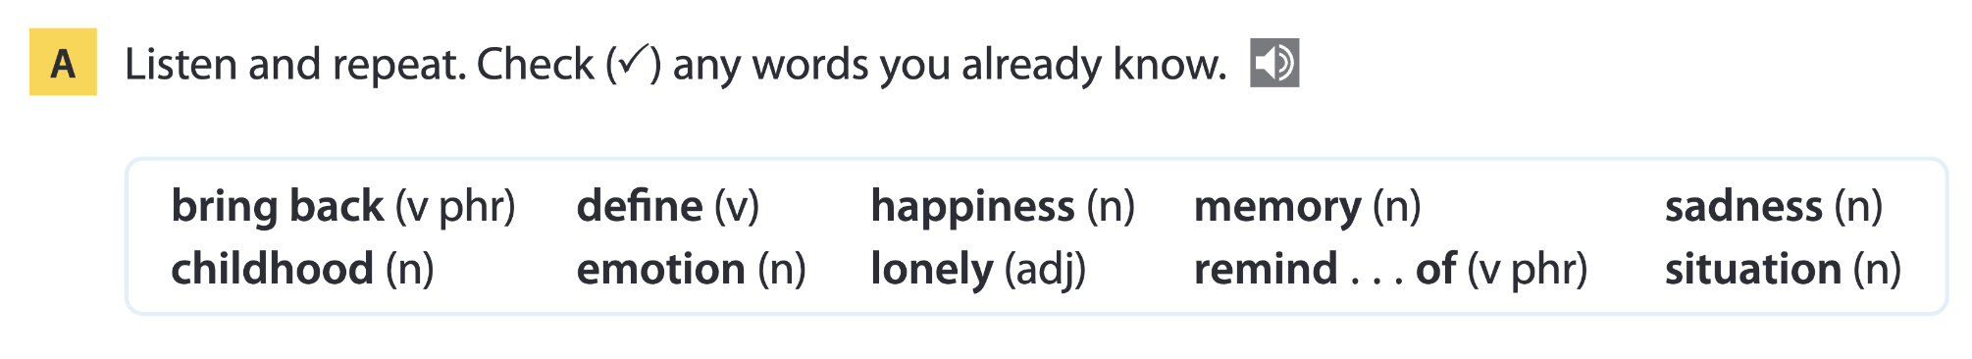
Page 24

Slide 8
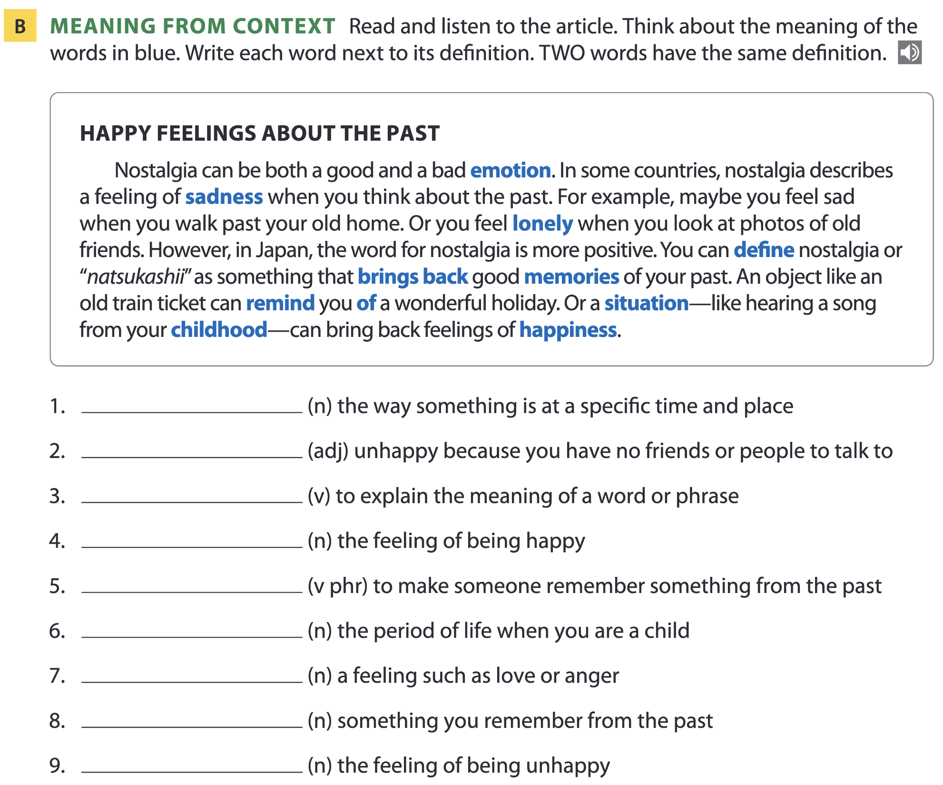
Page 24
situation
lonely
define
happiness
remind…of; bring back
childhood
emotion
memory
sadness

Slide 9
Vocabulary list
situation /ˌsɪtʃ.uˈeɪ.ʃən/ (n) – tình huống
lonely /ˈləʊn.li/ (adj) – cô đơn
define /dɪˈfaɪn/ (v) – định nghĩa
happiness /ˈhæp.i.nəs/ (n) – niềm hạnh phúc
remind…of; bring back /rɪˈmaɪnd əv/; /brɪŋ bæk/ (v phr) – gợi nhớ về
childhood /ˈtʃaɪld.hʊd/ (n) – tuổi thơ
emotion /ɪˈməʊ.ʃən/ (n) – cảm xúc
memory /ˈmem.ər.i/ (n) – ký ức
sadness /ˈsæd.nəs/ (n) – nỗi buồn

Slide 10
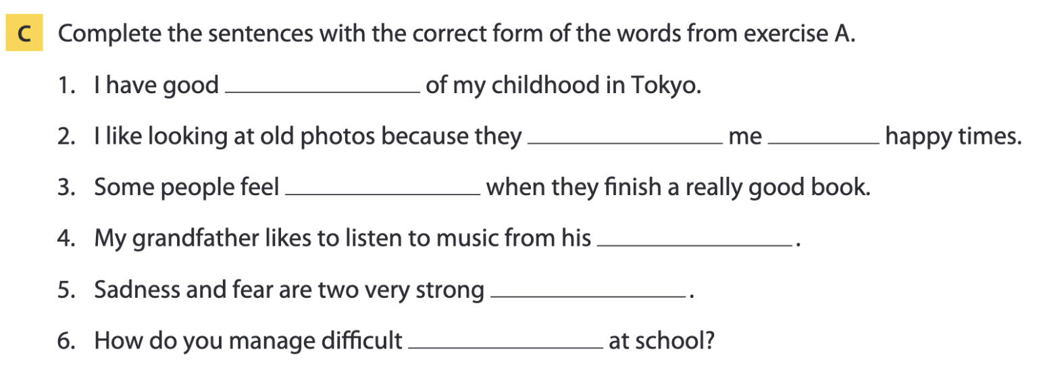
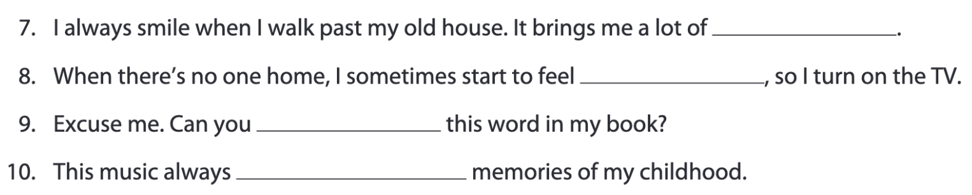
Pages 24-25
memories
remind of
sadness
childhood
emotions
situations
happiness
lonely
define
brings back

Slide 11
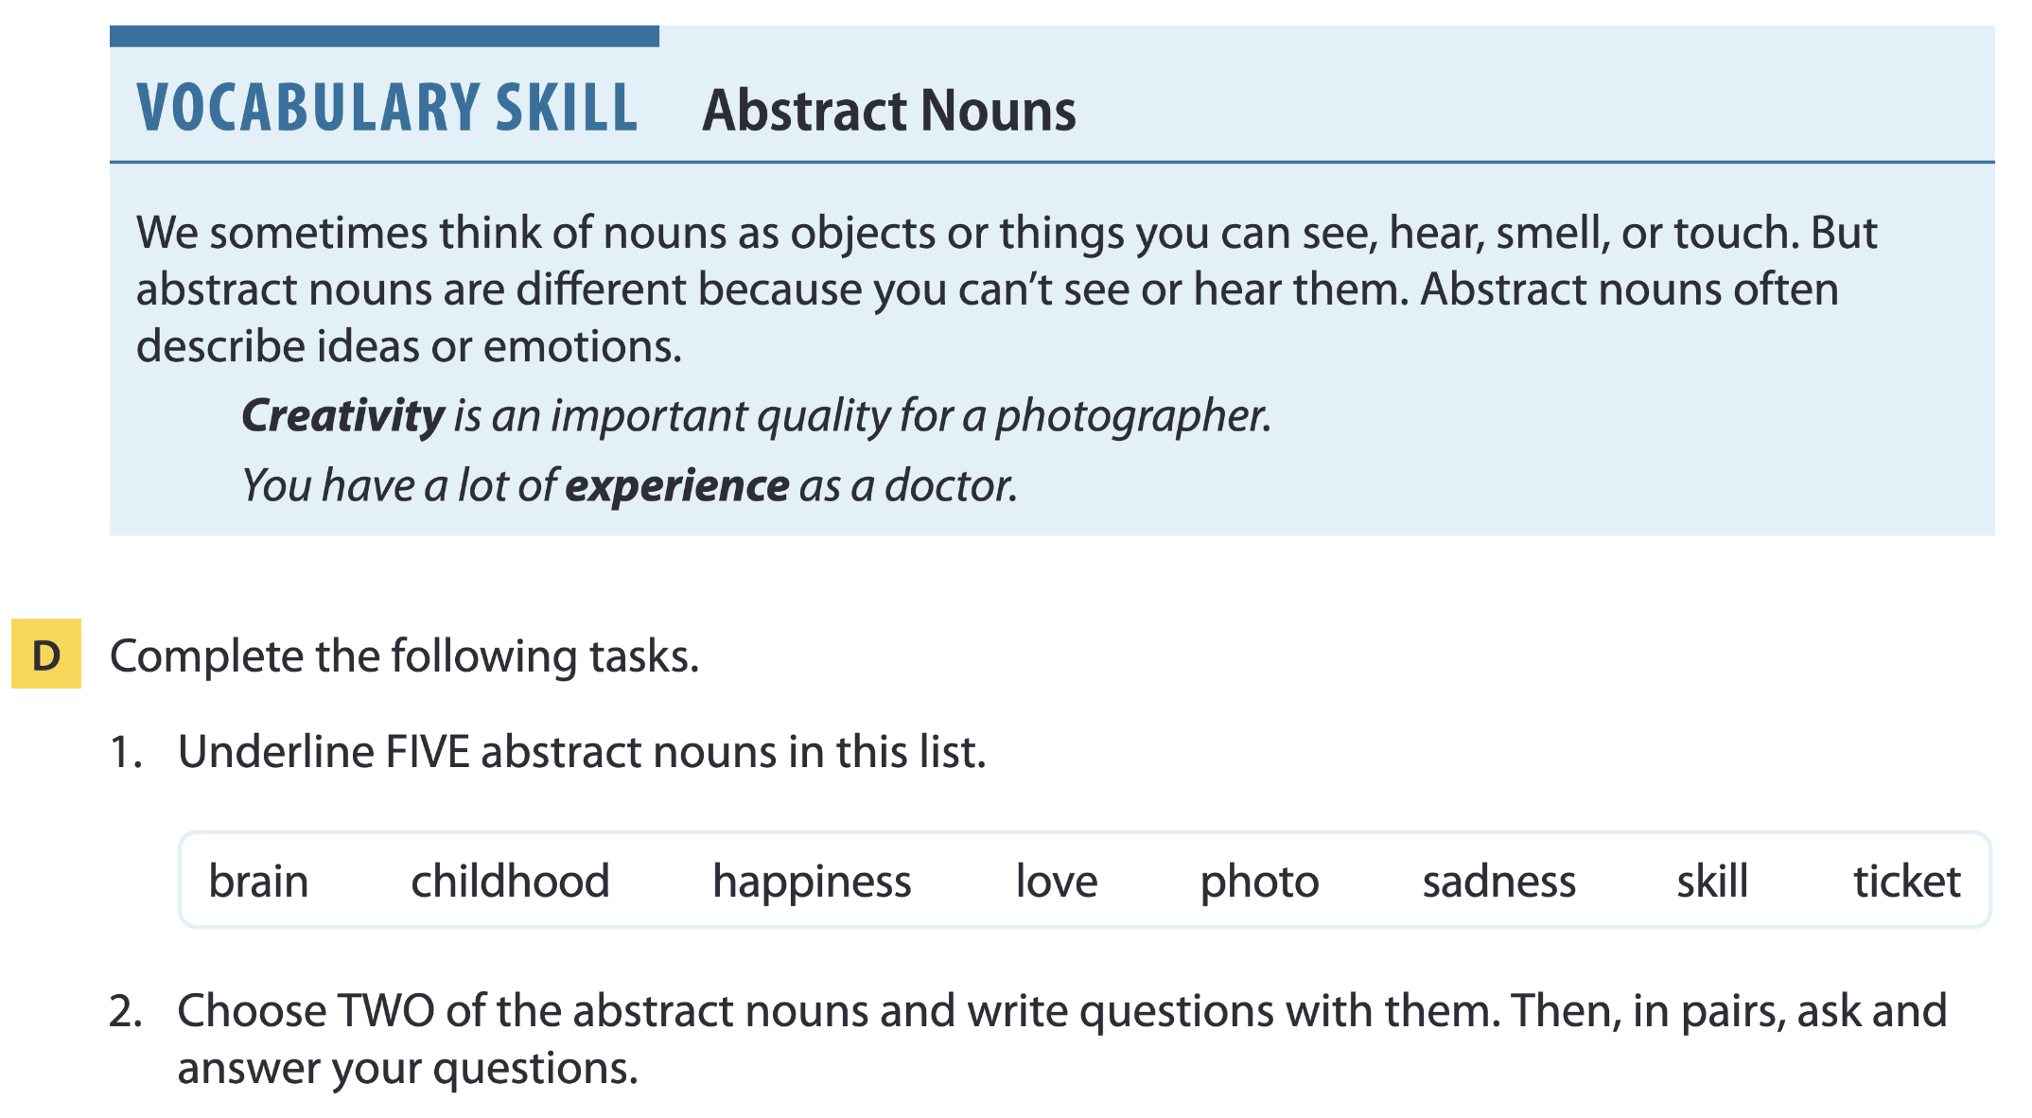
Page 25

Slide 12
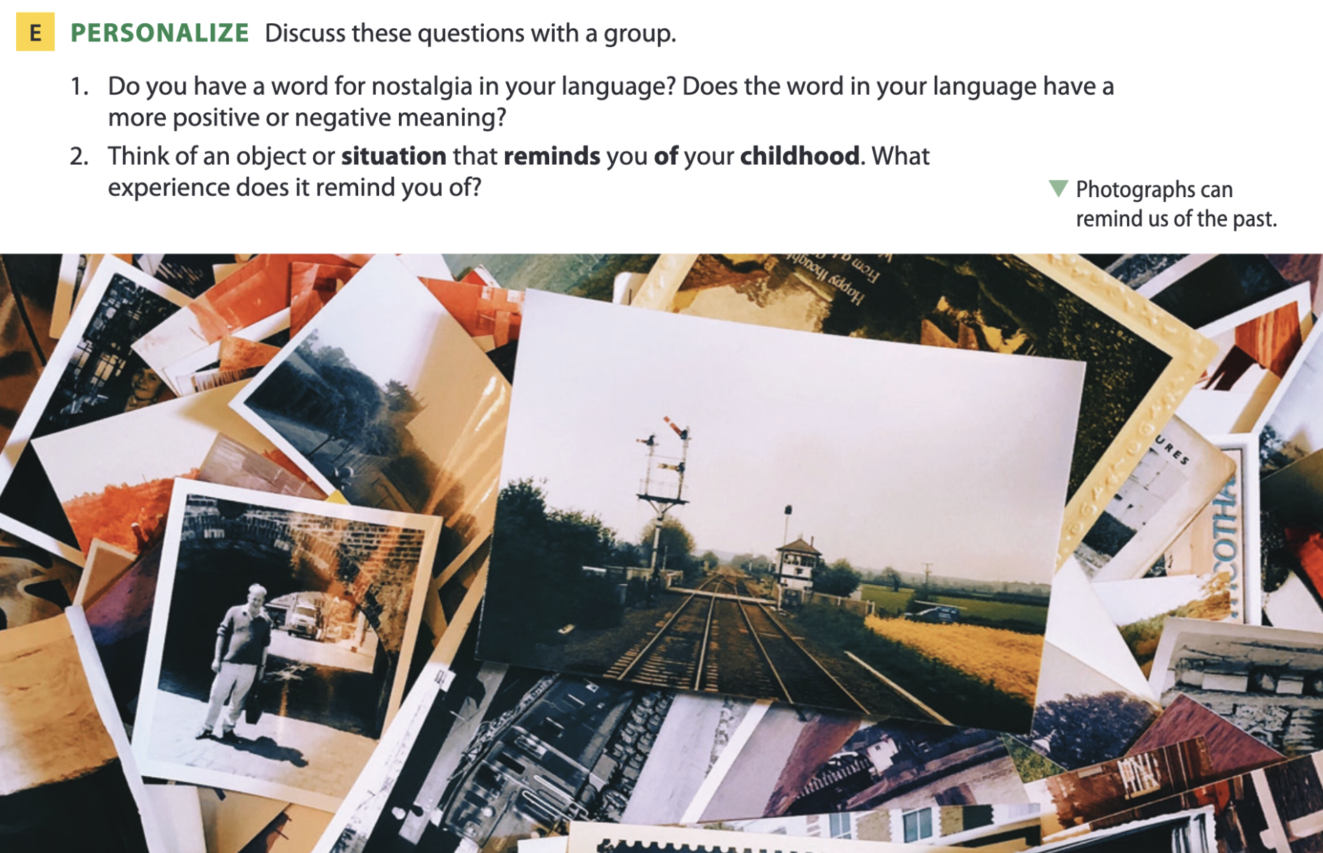
Page 25

Slide 13

02
Listening A

Slide 14
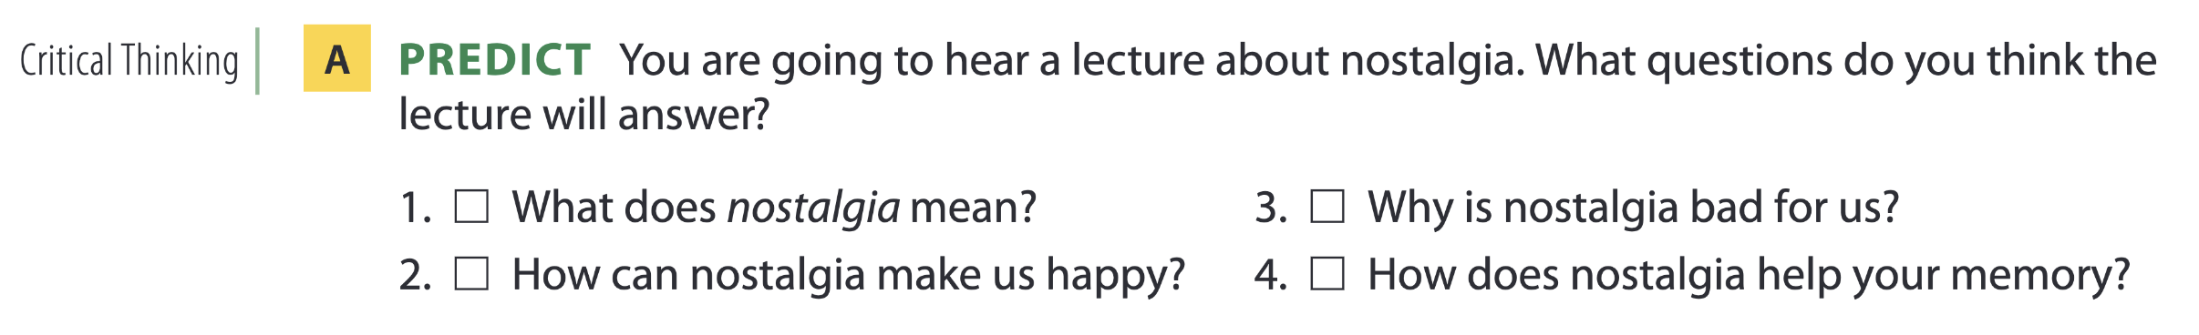
Remembering the past
Page 26

Slide 15
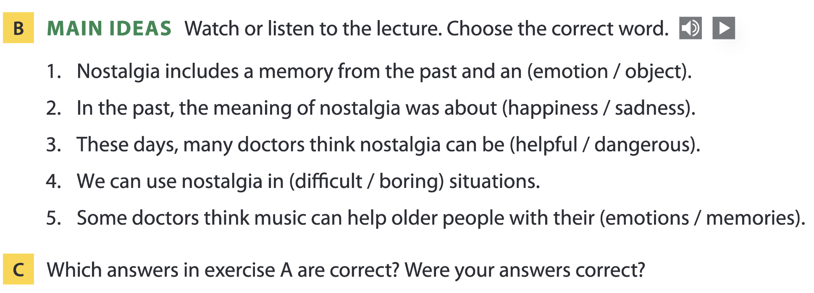

Page 26

Slide 16
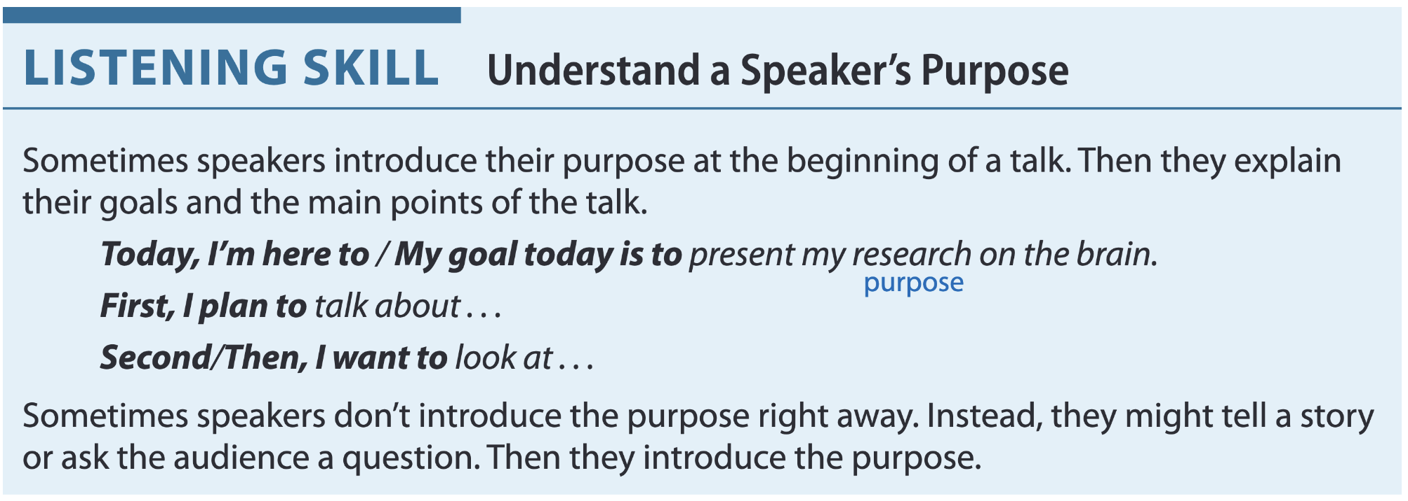
Page 27

Slide 17
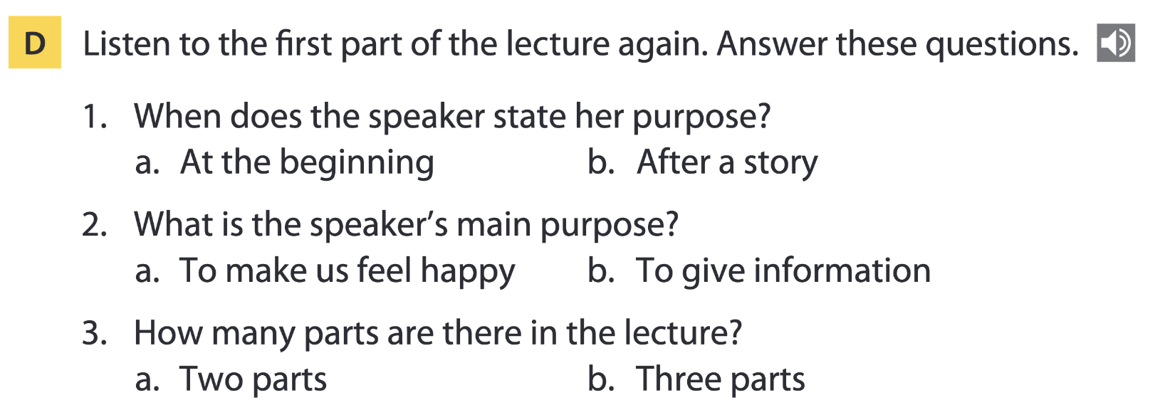
Page 27

Slide 18
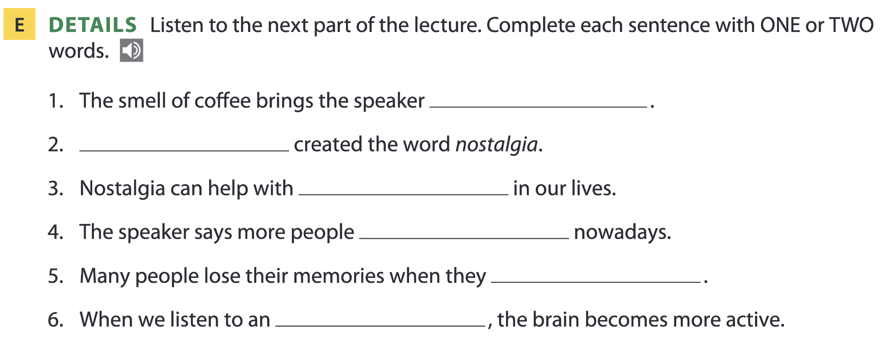
Page 27
happiness
A doctor
changes
live alone
get older
old song

Slide 19
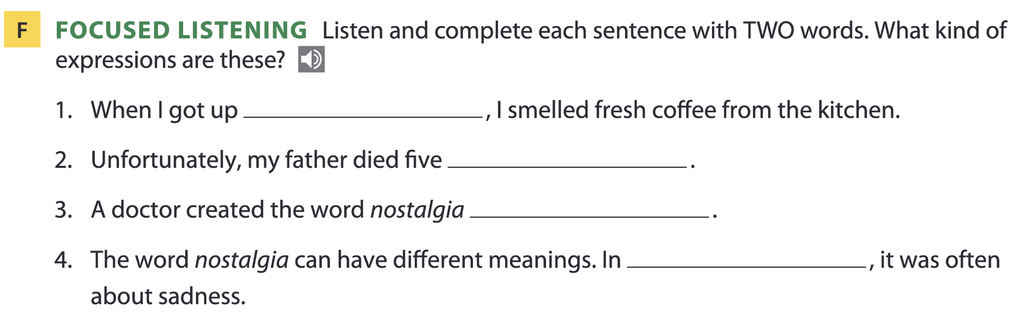
Page 27
=> These are all past time expressions.
this morning
years ago
in 1688
the past

Slide 20
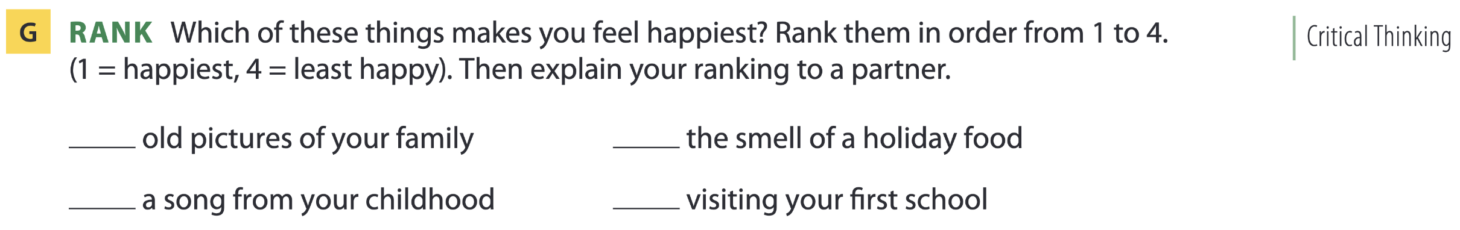
Page 27

Slide 21
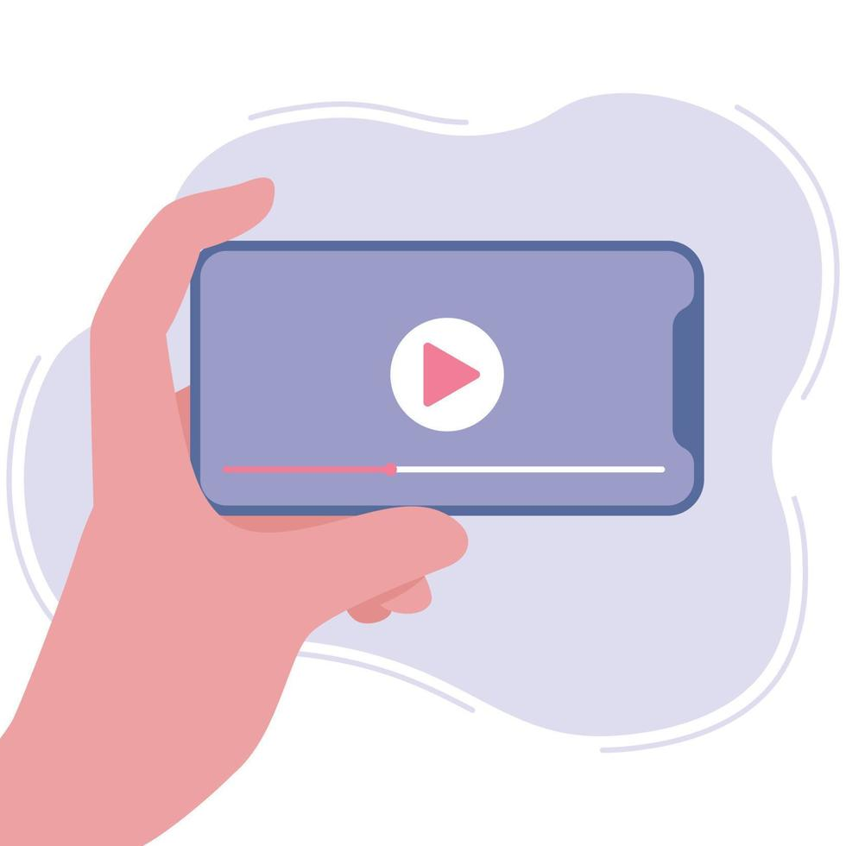
03
Video watching

Slide 22
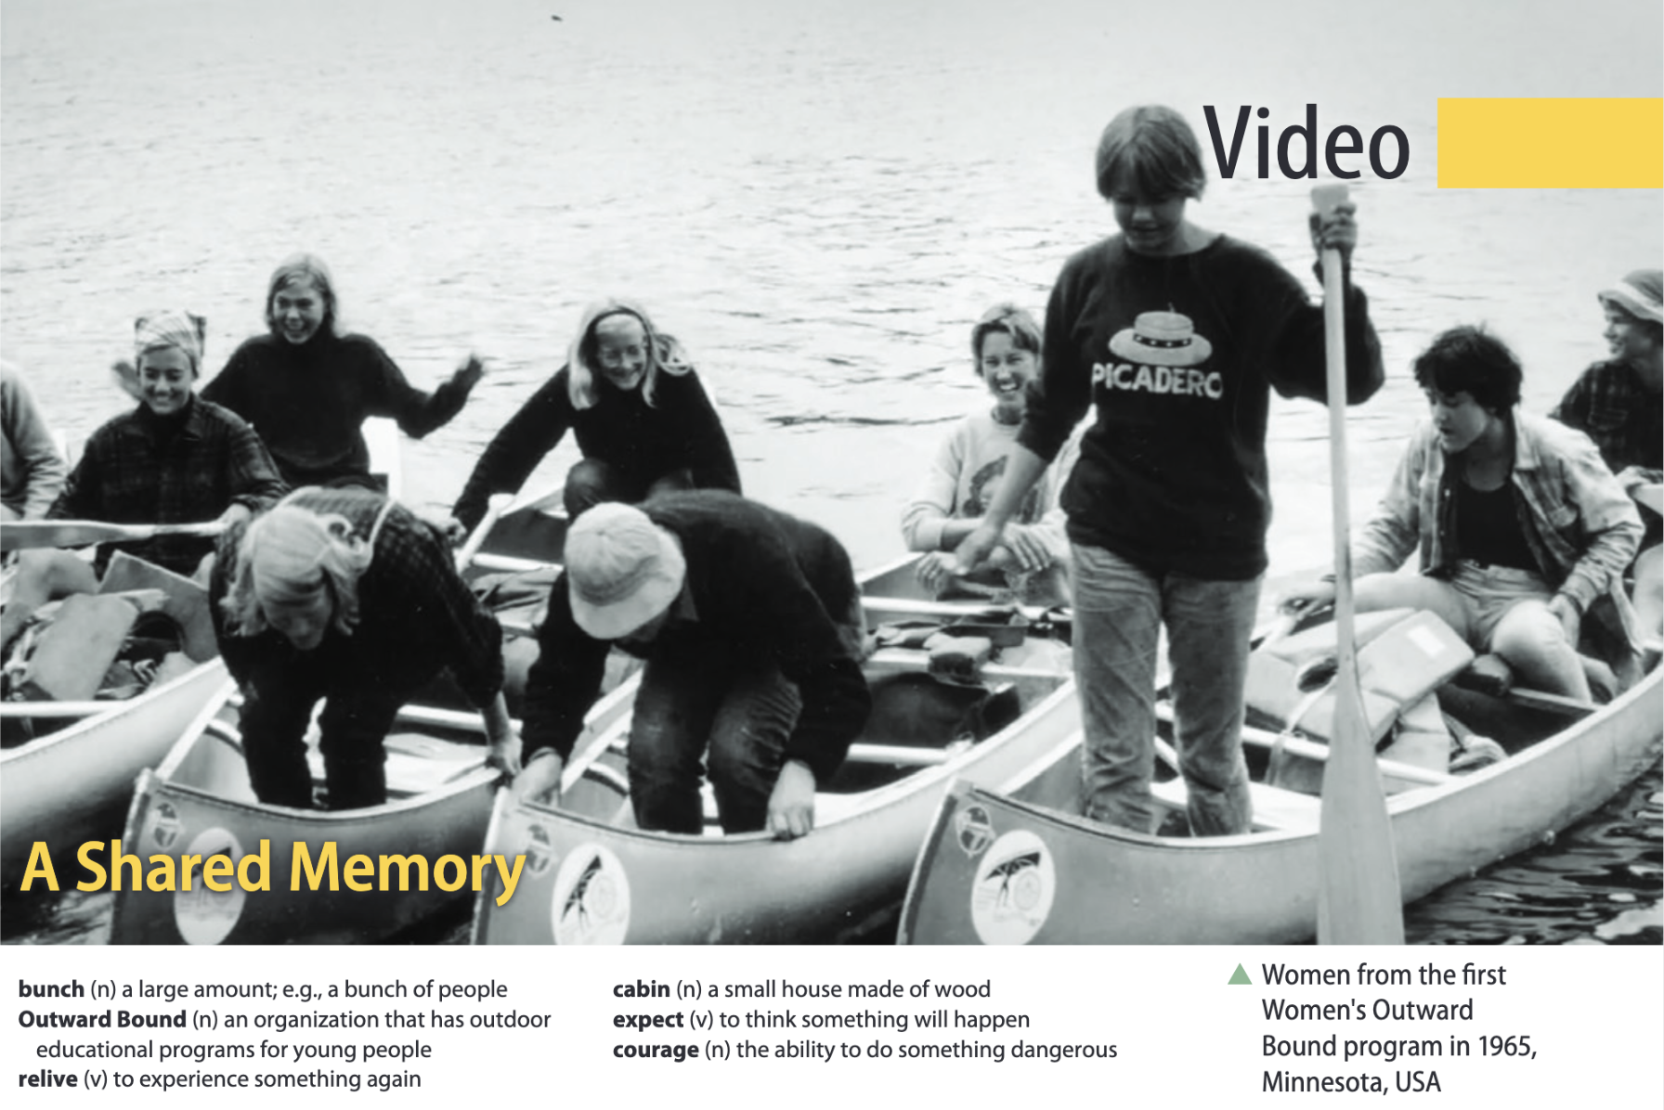
Page 31

Slide 23
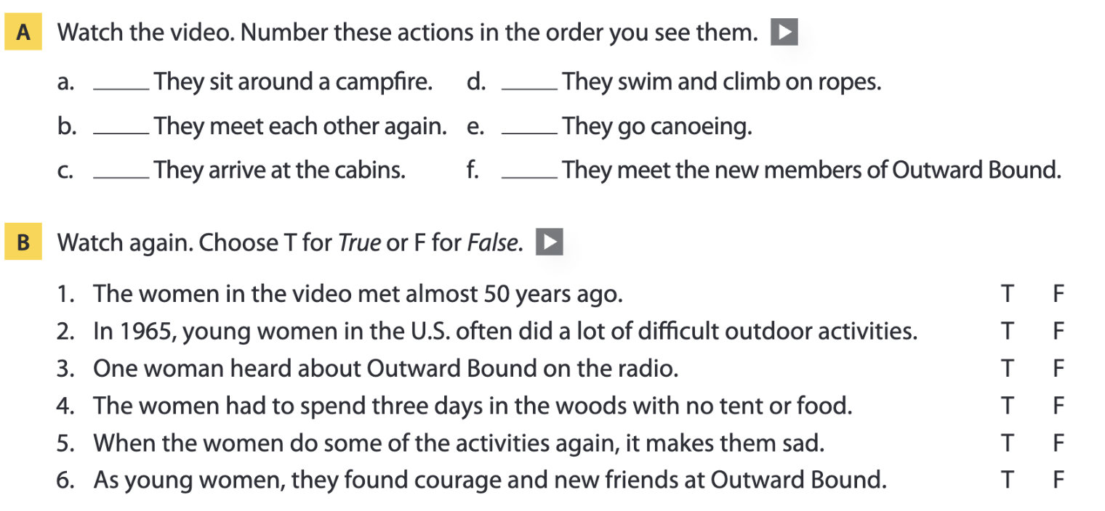
Page 31
6
4
1
5
3
2

Slide 24
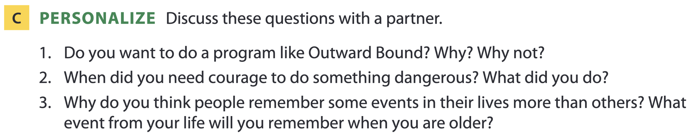
Page 31

Slide 25
04
Vocabulary B

Slide 26
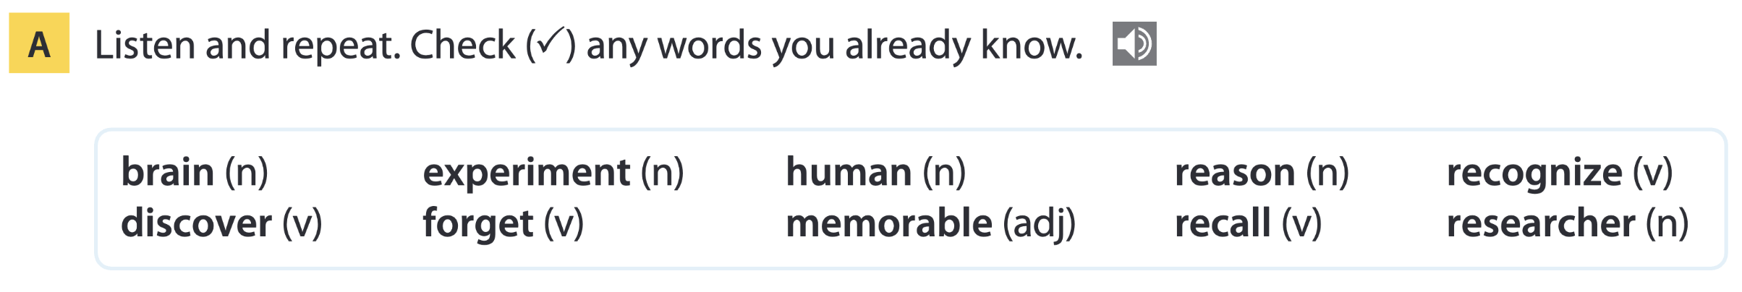
Page 32

Slide 27
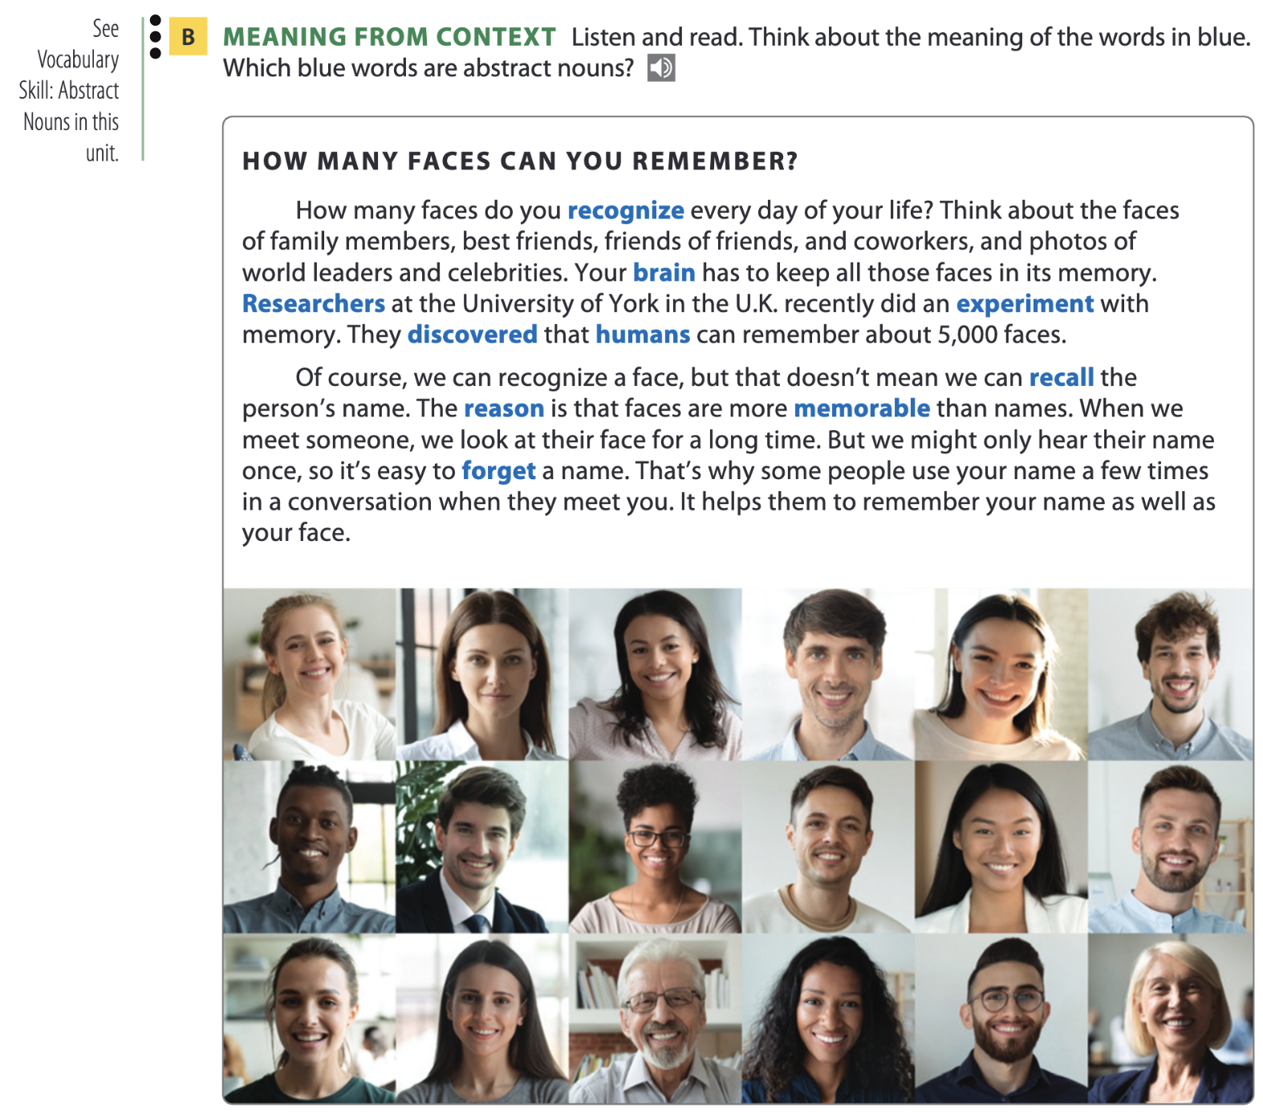
Page 32

Slide 28
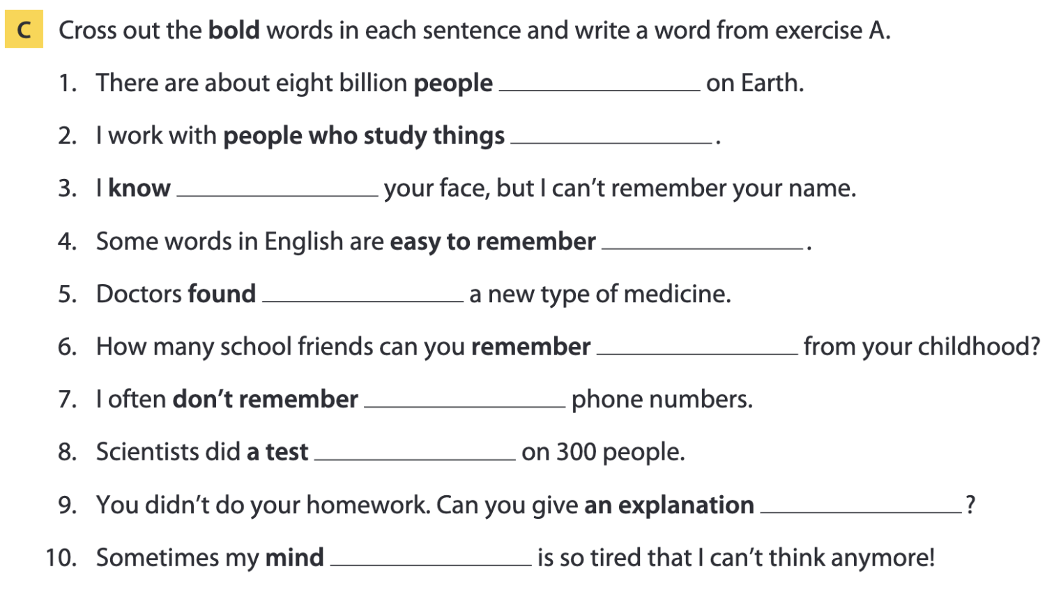
Page 33
humans
researchers
recognize
memorable
discovered
recall
forget
(an) experiment
(a) reason
brain

Slide 29
Vocabulary list
recognize /ˈrek.əɡ.naɪz/ (v) – nhận ra
brain /breɪn/ (n) – não
researcher /rɪˈsɜː.tʃər/ (n) – nhà nghiên cứu
experiment /ɪkˈsper.ɪ.mənt/ (n) – thí nghiệm
discover /dɪˈskʌv.ər/ (v) – khám phá
human /ˈhjuː.mən/ (adj, n) – con người
recall /rɪˈkɔːl/ (v) – hồi tưởng
reason /ˈriː.zən/ (n) – lý do
memorable /ˈmem.ər.ə.bəl/ (adj) – đáng nhớ
forget /fəˈɡet/ (v) – quên

Slide 30
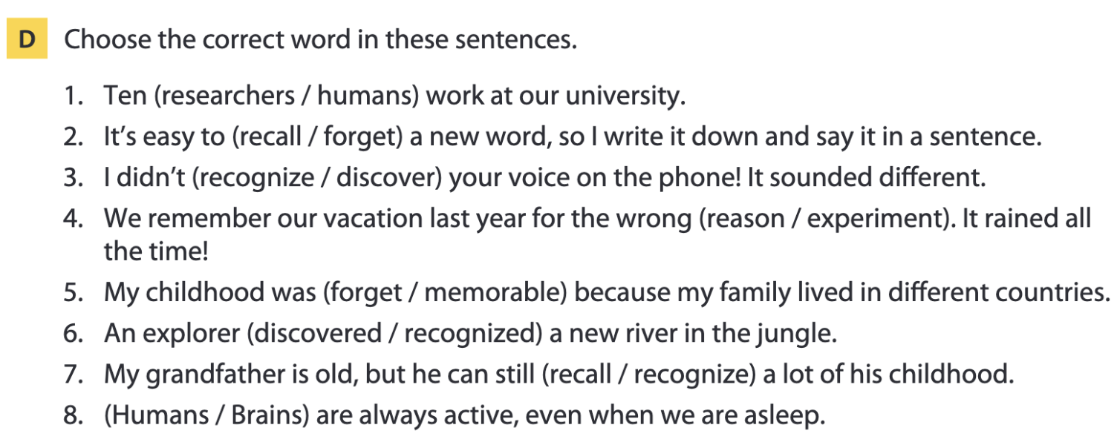
Page 33

Slide 31
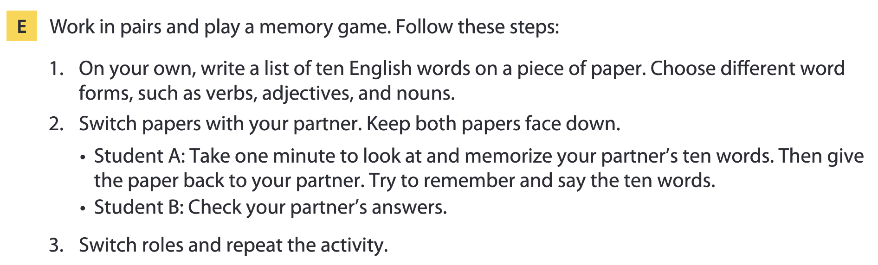
Page 33

Slide 32
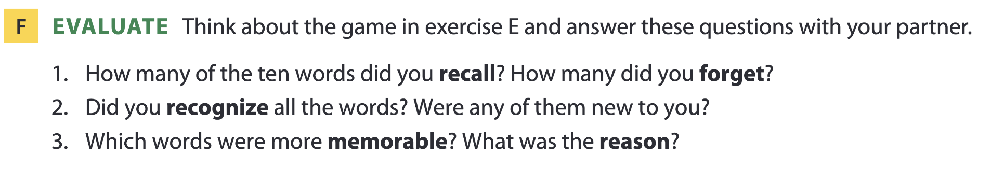
Page 33

Slide 33
05
Listening B

Slide 34
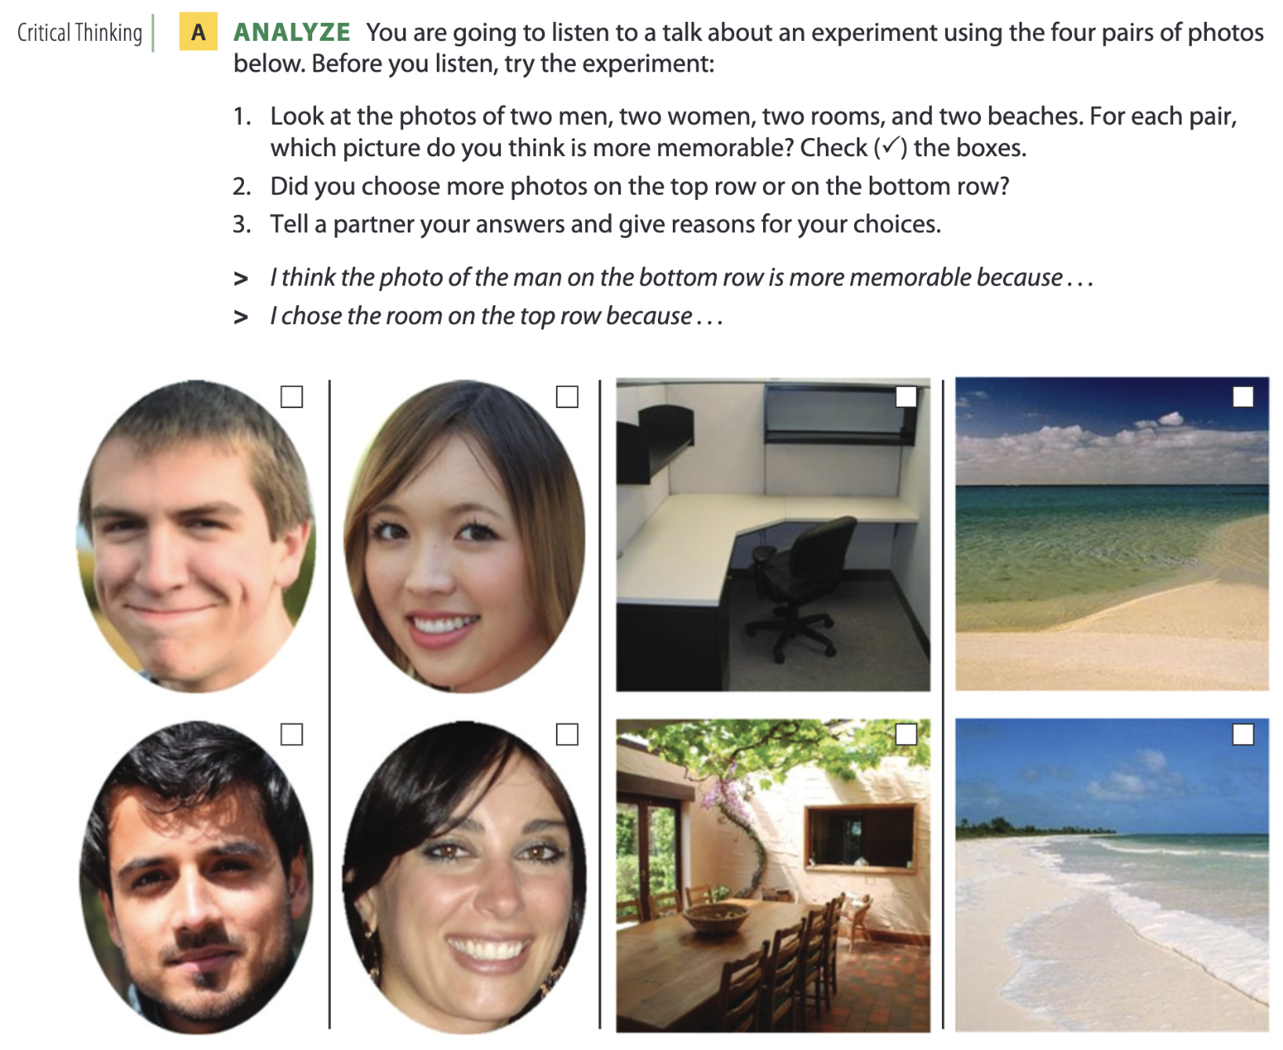
What do we remember?
Page 34

Slide 35
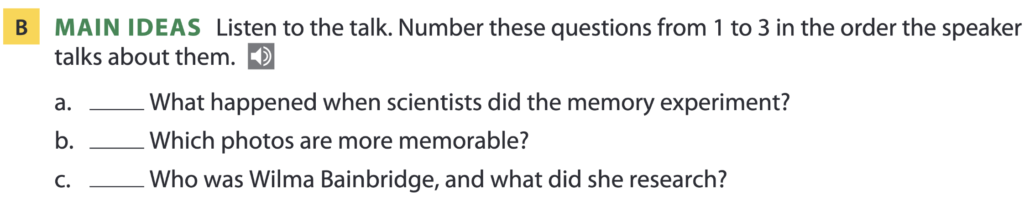
Page 34
2
1
3

Slide 36
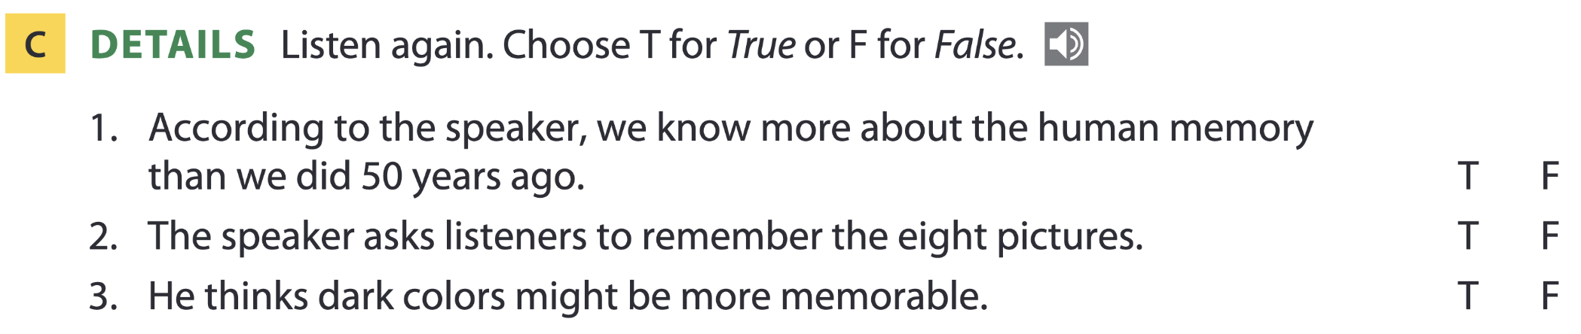
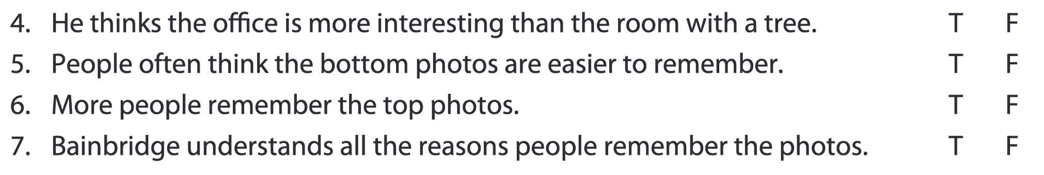
Pages 34-35

Slide 37
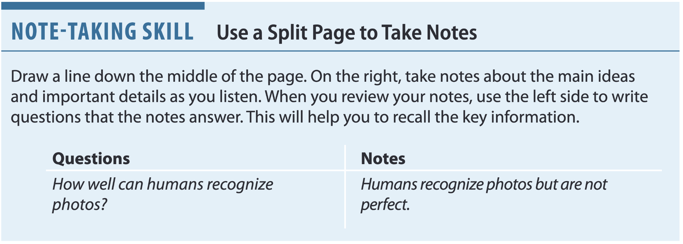
Page 35

Slide 38
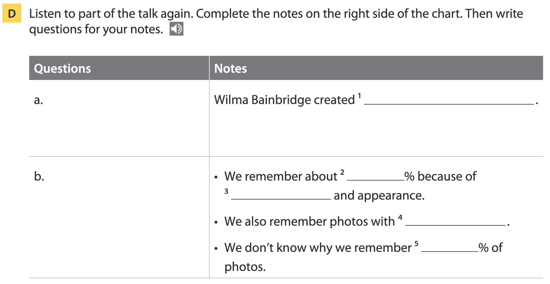
Page 35
the experiment
Who created the experiment?
60
color
people
What makes a picture memorable?
40

Slide 39
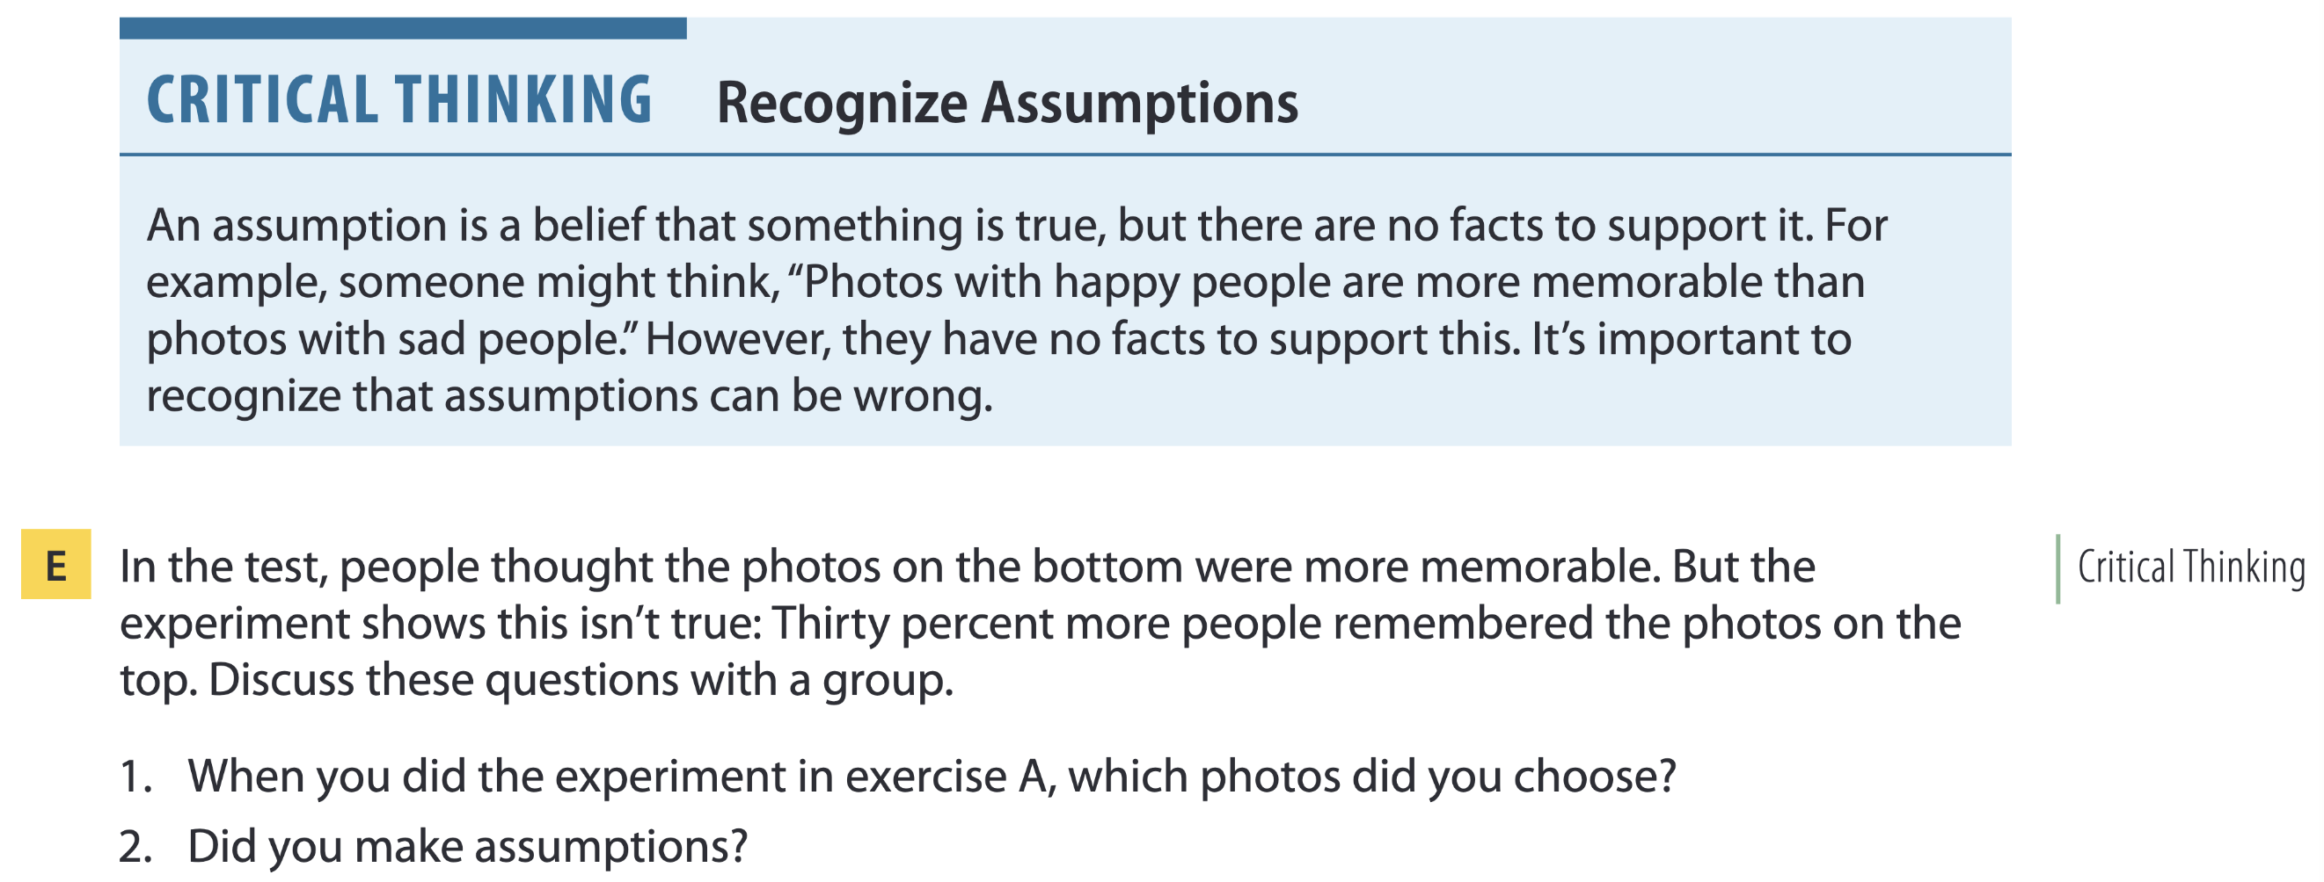
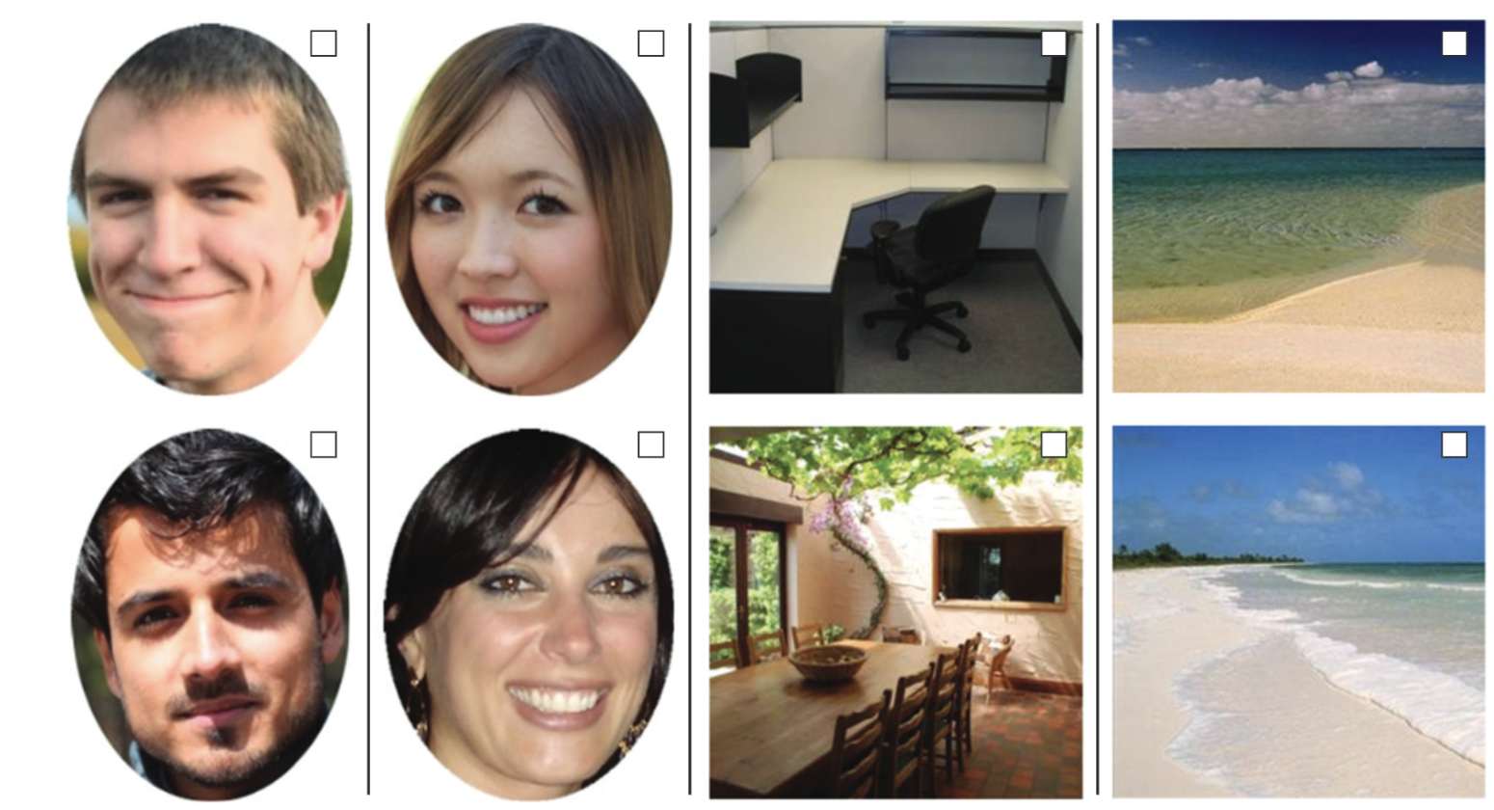
Page 35

Slide 40
THANKS FOR YOUR ATTENTION!

